Slide 1
Classification + Logistic Regression
CSE 416 - Section 2

Slide 2
Agenda
Classification Recap
Logistic Regression
Ed Notebook Demo

Slide 3
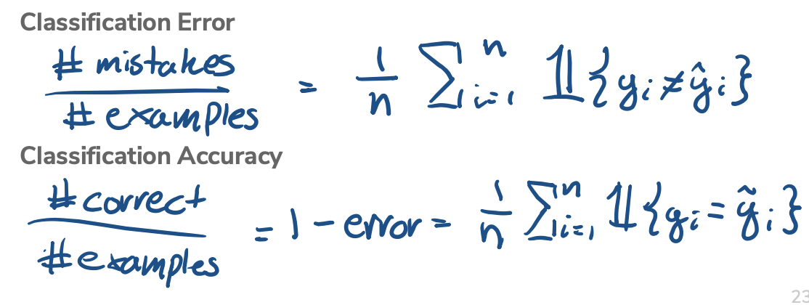
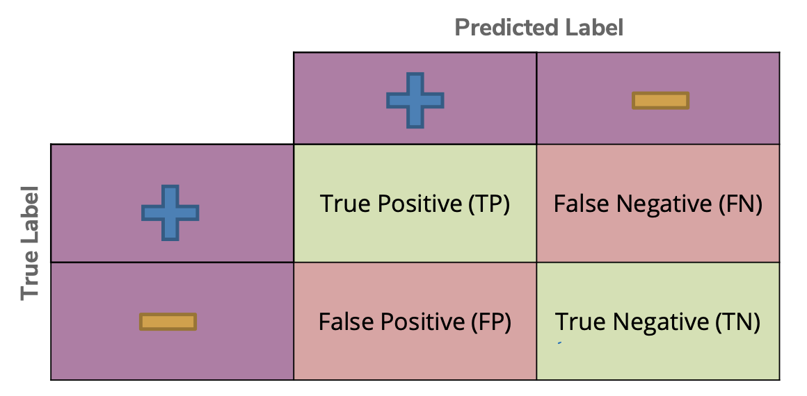
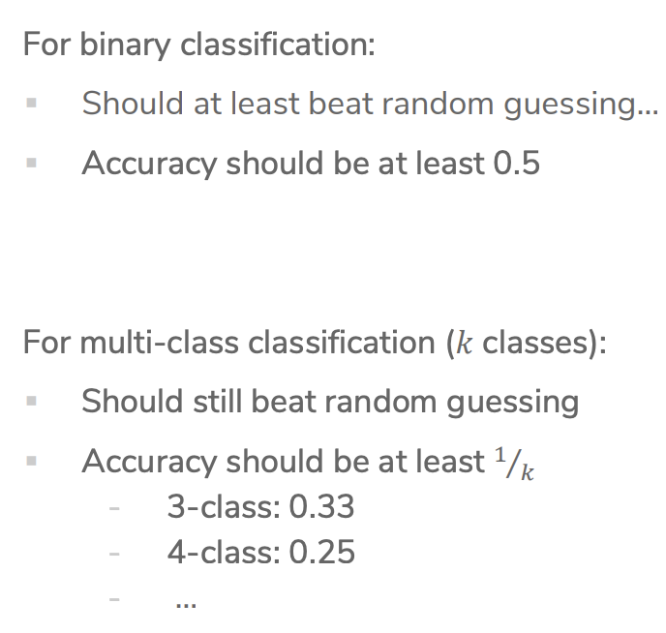
Classification Recap
Notes:
Classification error/accuracy - mention majority class classifier (baseline)
Confusion matrix, can use for multiclass
Binary classification should ideally beat random guessing. In binary classification, an algorithm or model is used to classify elements into one of two groups based on input data. The goal of a binary classification model is to make predictions that are more accurate than random guessing, which would have a 50% accuracy rate since there are only two possible outcomes.
For instance, in a scenario where you're trying to predict whether an email is spam or not (binary classification), guessing randomly would result in being correct about half the time. A well-designed and trained binary classification model should learn from the features of the emails (like certain keywords, sender information, etc.) and make predictions that are significantly better than a 50% success rate, indicating it has learned patterns that distinguish spam from non-spam emails effectively.

Slide 4
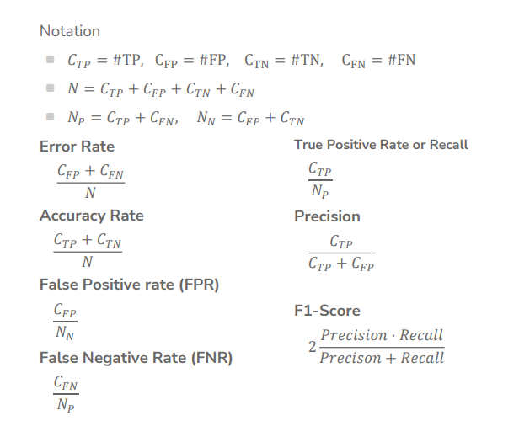
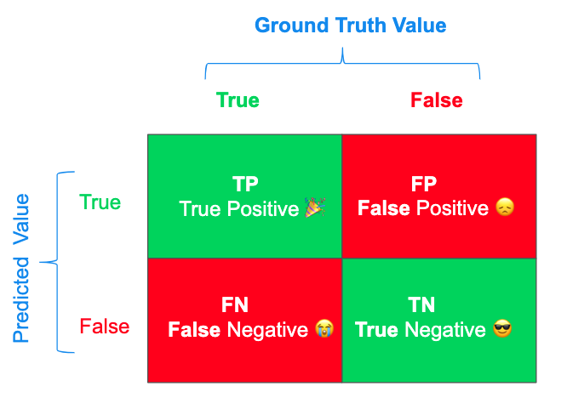
Classification: Binary Measures
Recall= how many times the model was able to detect a specific category
Accuracy= how many times the ML model was correct overall
Precision= how good the model is at predicting a specific category
Notes:
Precision
Imagine you created a machine to find all the red apples in a mix of red and green apples. Precision tells you how many of the apples it picked as red were actually red. It's about being correct when the model says "yes." If the machine says, "This is a red apple," precision reflects how often it's right about that.
Recall
Using the same red apple machine: recall tells you how many of the actual red apples in the mix your machine managed to find. It's about not missing out on what you're looking for. If there are 100 red apples and your machine finds 90, your recall is quite good because it found most of the red apples.
F1 Score
The F1 Score is like a balance between precision and recall. Sometimes, if you try to improve precision (making sure what you pick is right), you might end up missing some of the things you should have picked (recall). Or, if you try to get everything (improving recall), you might start picking things that are wrong (lowering precision). The F1 Score tells you how well you managed to keep a balance between not missing out on what you're looking for and being right when you say you found it.
Each of these metrics gives you a different piece of the puzzle when evaluating how good a model is at classifying or making predictions, helping you understand its strengths and weaknesses in simple terms.

Slide 5
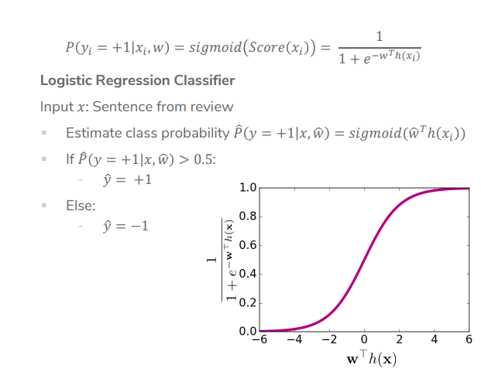
Logistic Regression Recap: Model & Prediction
Notes:
Sigmoid function used for logistic regression
Logistic regression is a probability classifier- have magical thing that learns coefficients, apply coefficients to the features to get a score and then feed the score to the sigmoid function to get a probability to make a prediction
Sigmoid score(x) uses a function that takes numbers arbitrarily large/small and maps them between 0 and 1
As score increases, sigmoid score will gradually increase up until 1

Slide 6
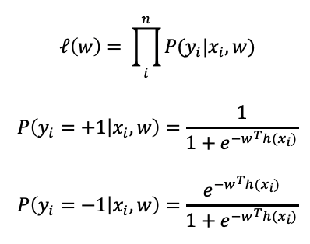
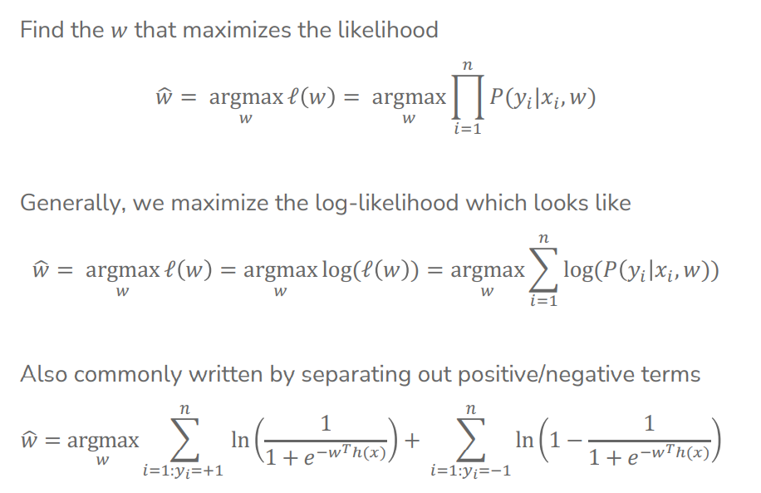
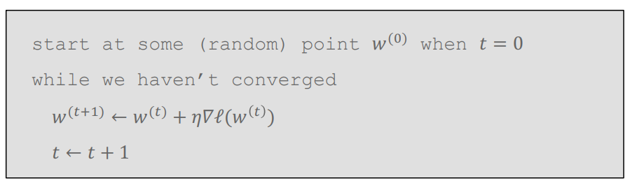
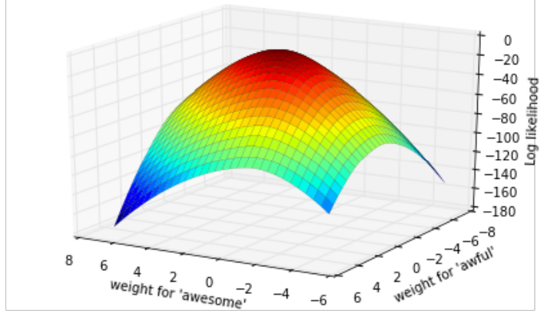
Logistic Regression Recap: Model Training
Gradient Ascent:
Notes:
Quality metric
Maximize likelihood, usually take log to compute easier
For pos examples penalizes small sigmoid(S)
For neg examples penalizes large sigmoid(S)
Find max using gradient ascent, eta is a hyperparameter (grid search)

Slide 7
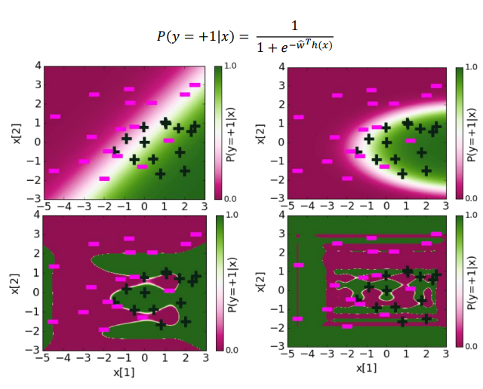
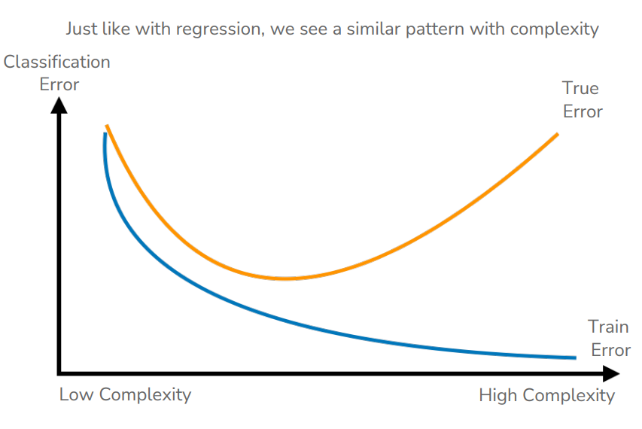

Logistic Regression Recap: Complexity & Decision Boundary
Notes:
Talk about overfitting
White space on the graph
Big coefficients lead to complicated decision boundaries
Using similar metrics to determine overfitting as in linear regression
Sharper functions
Fix using regularization
L2 norm
Could even use L1 norm

Slide 8
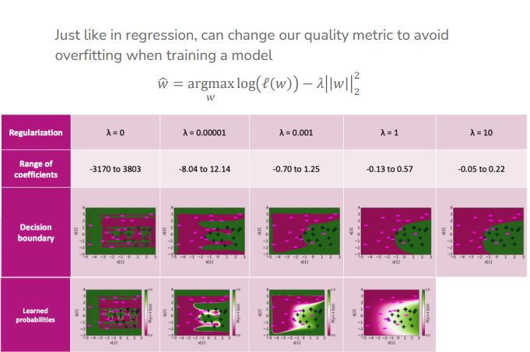
Logistic Regression: Regularization

Slide 9
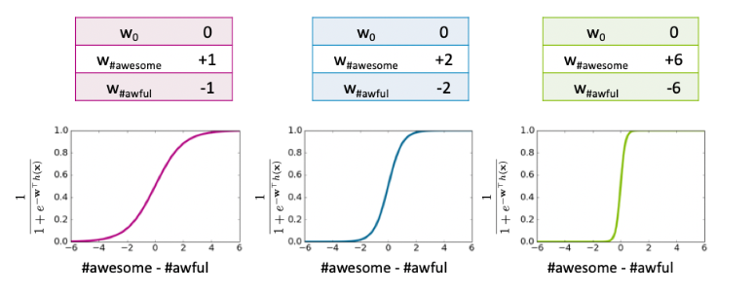
Logistic Regression Recap: How weights affect prediction
[Discussion Question] How will our prediction be different by using three different set of coefficients above?

Slide 10
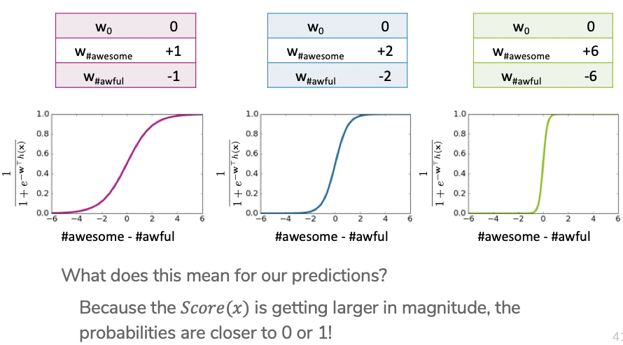
Logistic Regression Recap: How weights affect prediction

